Slide 1

Step-Based In-Place Walking Locomotion
A VR LOCOMOTION TECHNIQUE FOR PARKOUR SCENARIOS
Zeyu Liang

Slide 2

· Introduction
· Background Research
· Technical Implementation
· Demo
· Reflection and Future Development
3

Slide 3
Introduction
This project explores a step-based walking-in-place locomotion technique for VR parkour scenarios, where users’ in-place walking movements are mapped to continuous virtual movement.

Slide 4
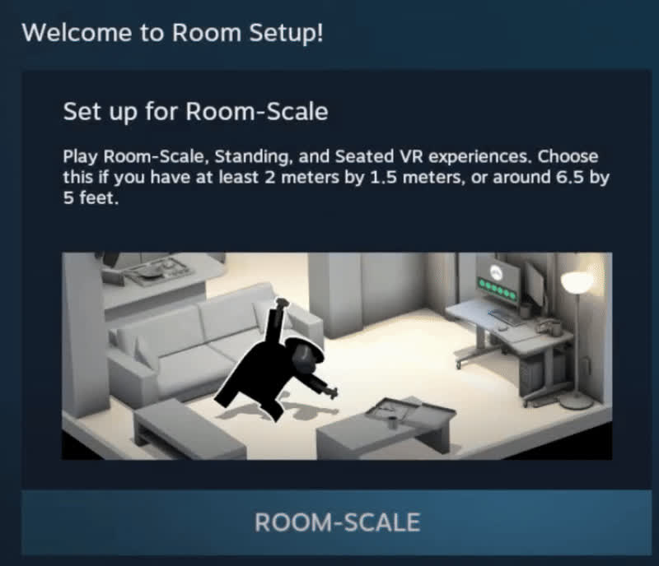
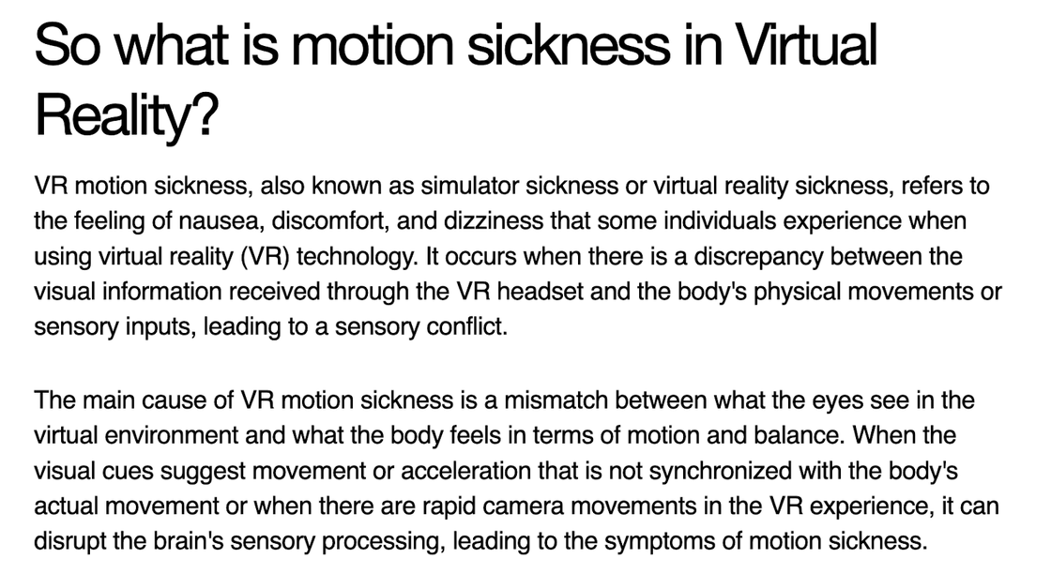
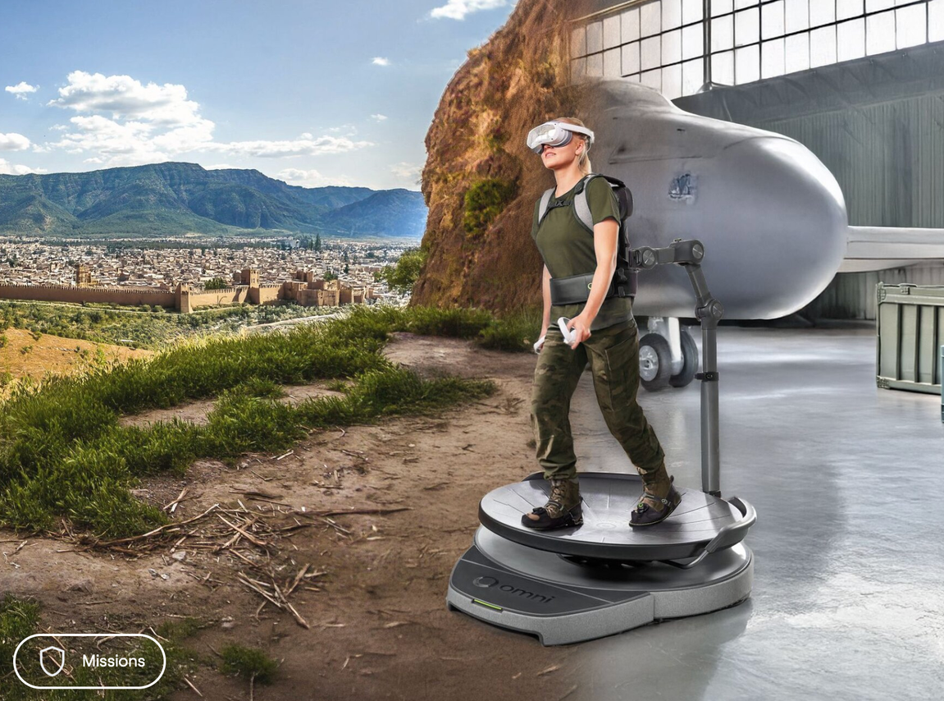
Background Research
· Motion Sickness in VR
· Existing Projects
· HTC Vive Room-scale VR
· Virtuix Omni

Slide 5
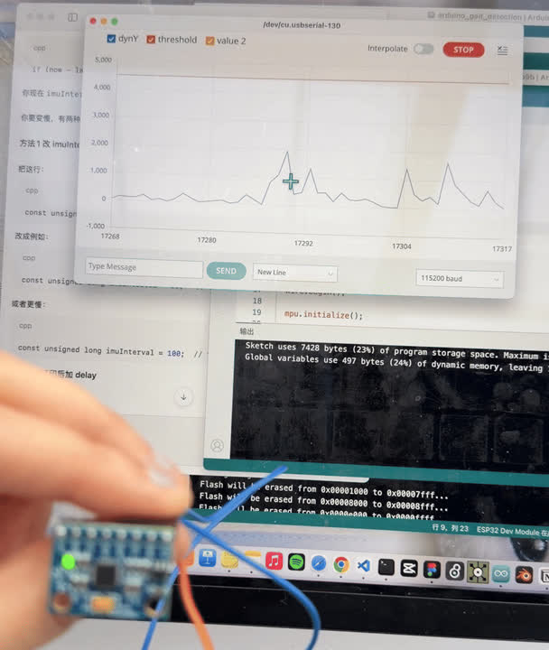
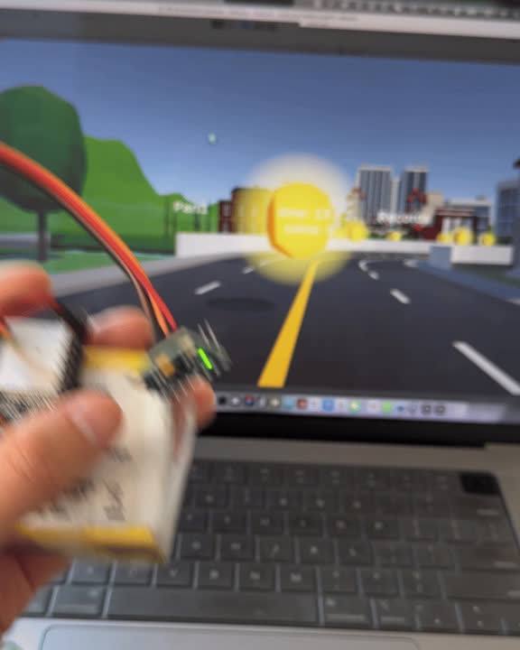

Technical Implementation
My blog: https://djwdb2333.github.io/labs/lab5/lab5.html
Three components: MPU6050, ESP32, and WebSocket.

Slide 6
Demo time

Slide 7
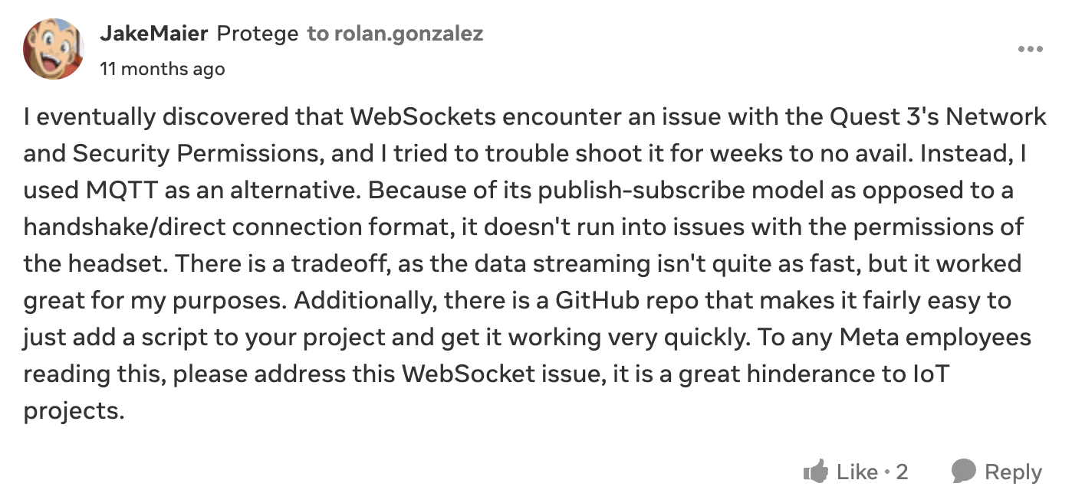
Possible reasons for the communication problem
ESP32 AP mode may be unstable
WebSocket may not be fully compatible with Quest 3

Slide 8
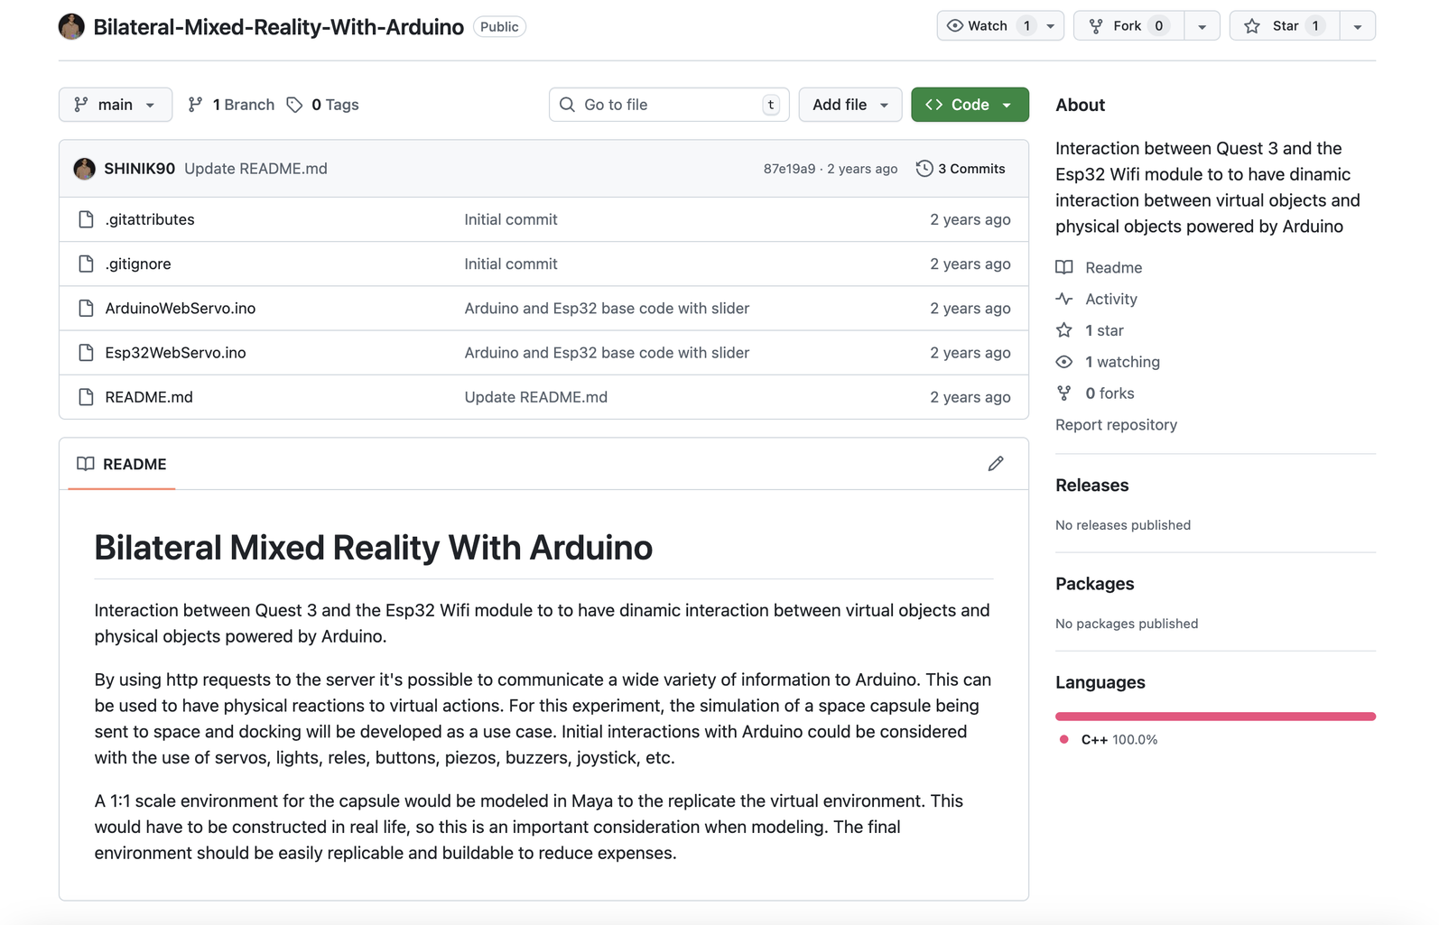
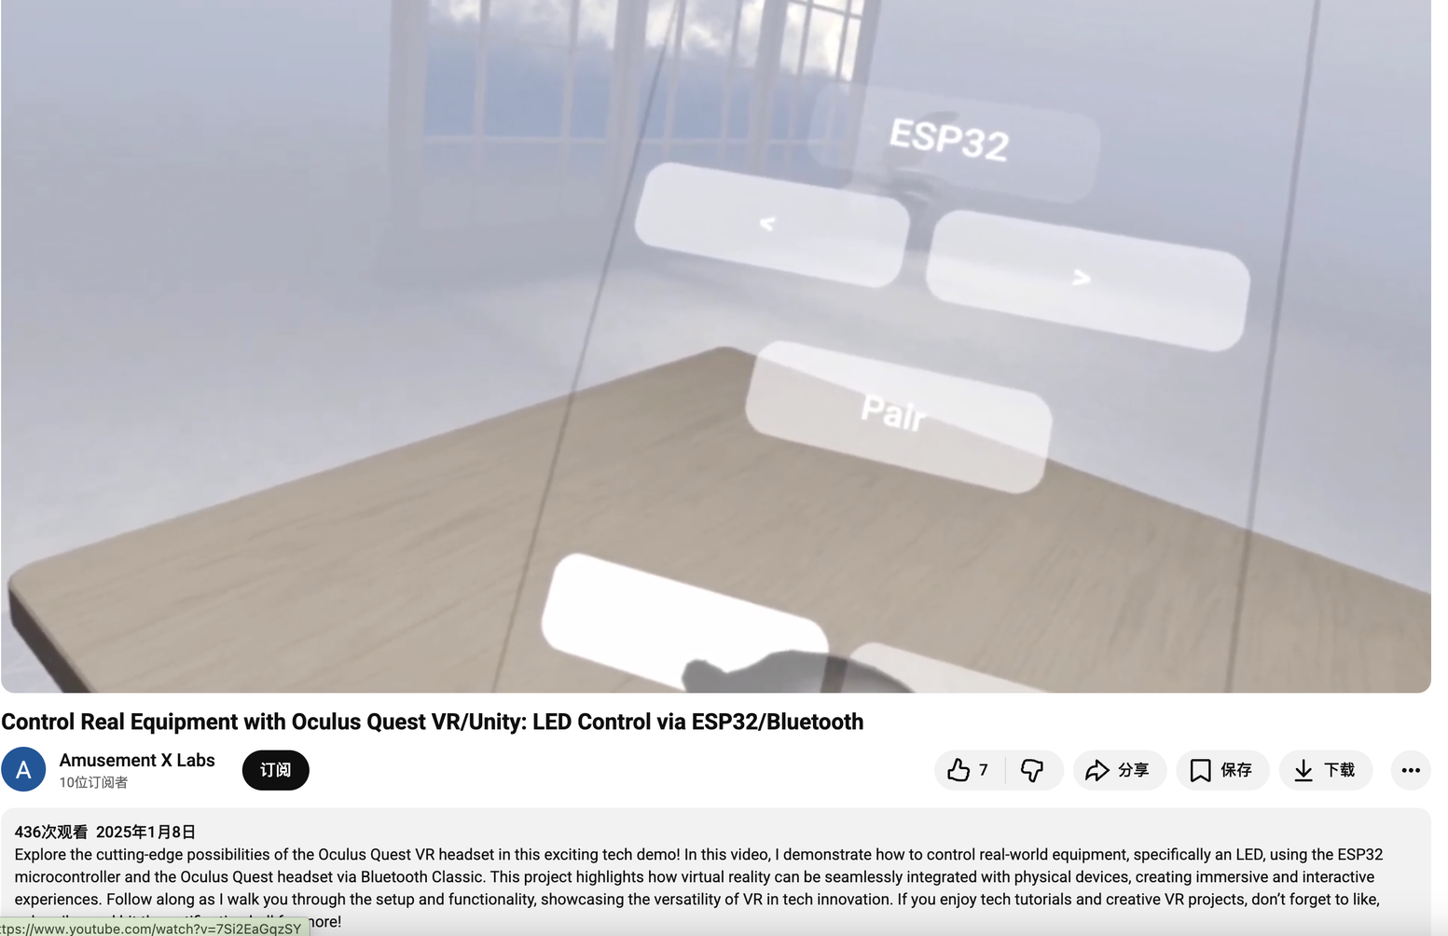
Solutions for the communication problem
Phone hotspot
MQTT
HTTP
Bluetooth

Slide 9
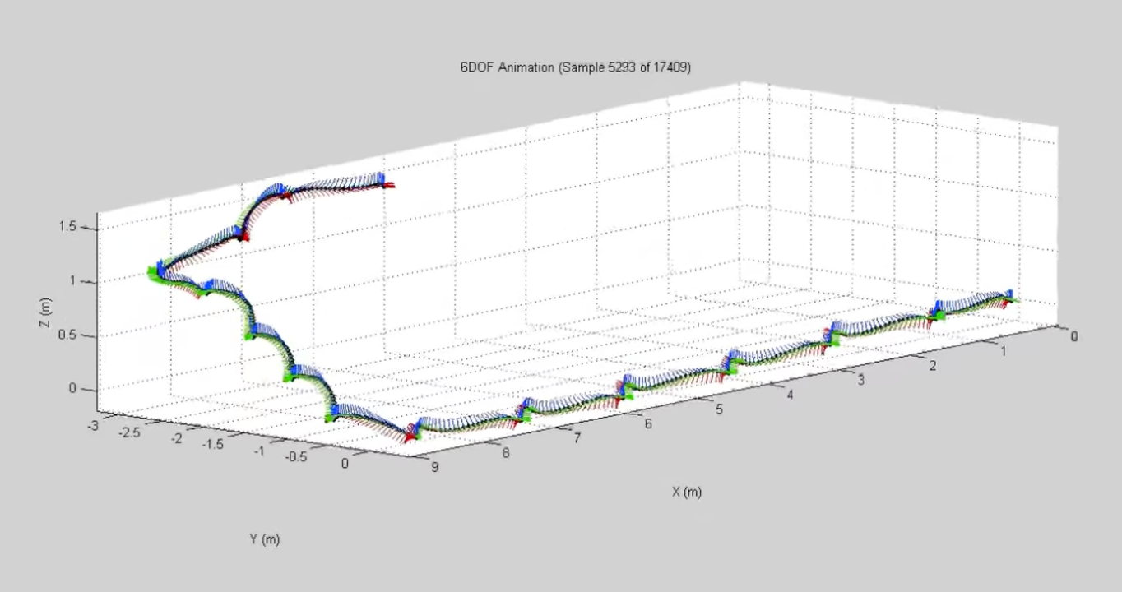
Reflection and Future Development
Sebastian’s Phd research

Slide 10
Thank you

